Slide 1
Pre-certification testing why, when, where, & how
James Jarvis
APRS World, LLC
www.aprsworld.com

Slide 2
Why?
“Certification Testing”
NOT DESIGN TESTING!
NOT PROTOTYPE TESTING!
Is expensive
Is not convenient
Likely need to be restarted if changes are made
Design should be tested before certification testing is started.

Slide 3
When
As soon as possible!
Test components
Test sub-systems
Test systems

Slide 4
Where
Office
Shop
Highway
Field

Slide 5
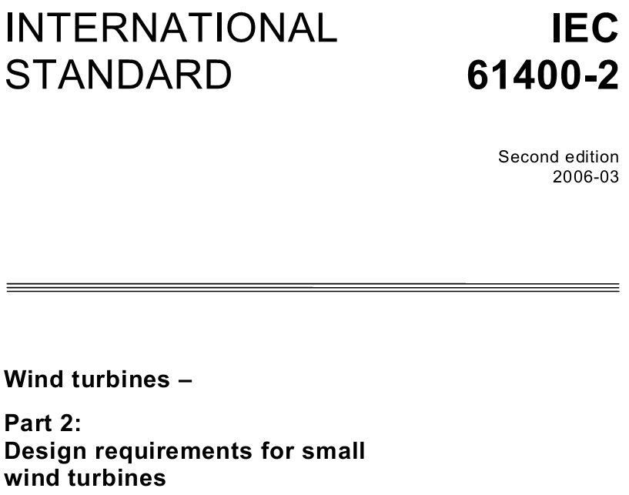
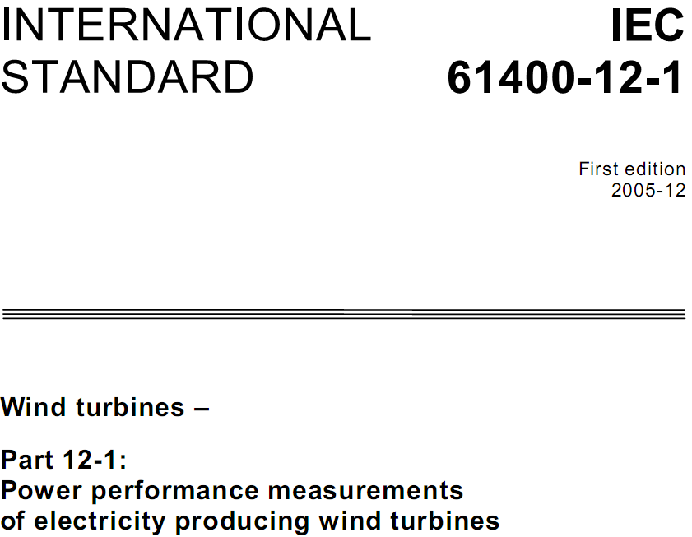
Where - Office: Design for test
Design turbine to IEC standards.
Model test setup to IEC standards where reasonable and feasible

Slide 6
Where - Shop: Dynamometer
Availability
Controlled lab environment
Controlled RPMs, torque
Mechanical forces can be measured
Ideal for safety testing
Generator testing only, no airfoils
Capital $$$ intensive
Pros
Cons

Slide 7
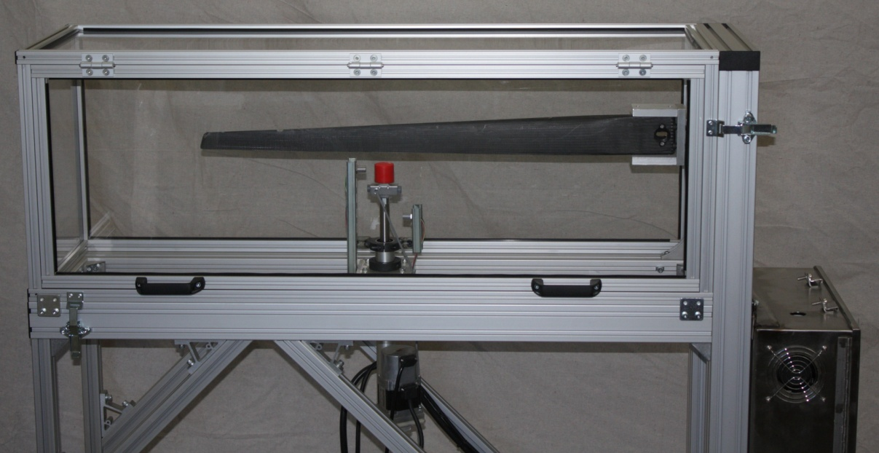
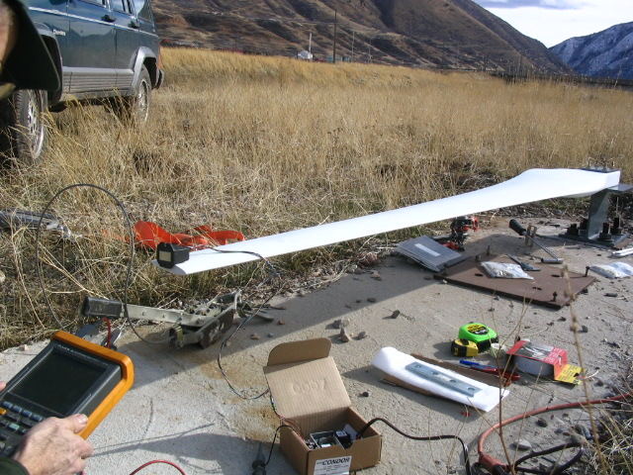
Dynamometers, Blade
Photo from APRS World, LLC
Photo from Windward Engineering / Endurance

Slide 8
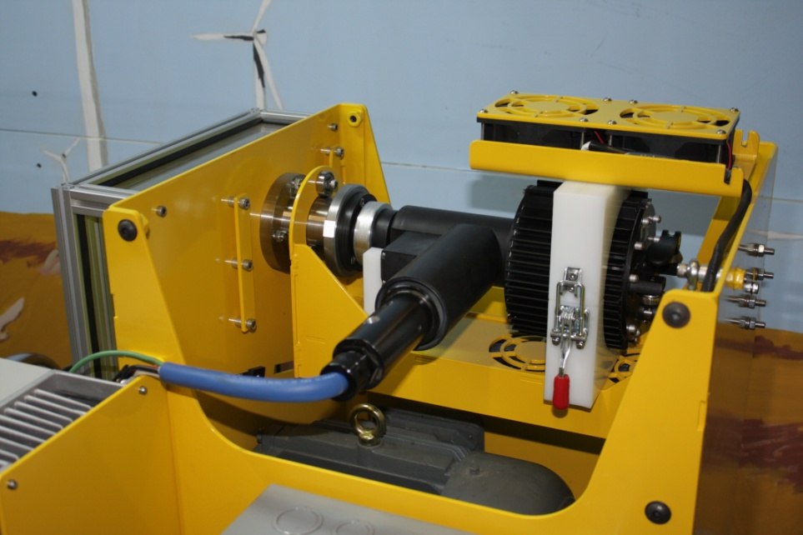
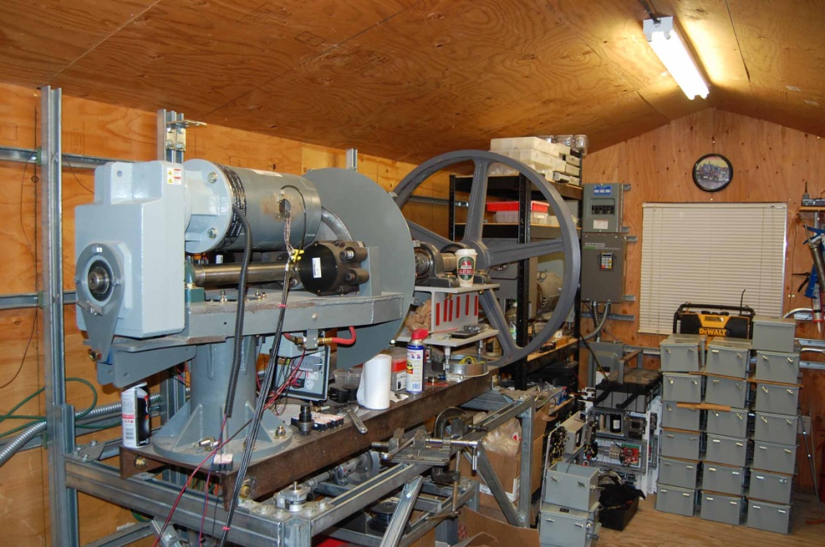
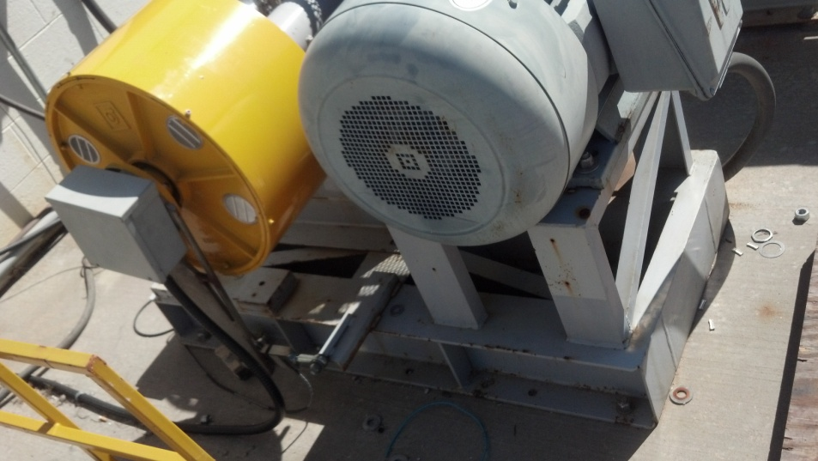
Dynamometers, Generator
Photo from APRS World, LLC
Photo from Windward Engineering / Endurance
Use the same test equipment for production testing
Photo from Bergey Wind Power Company

Slide 9
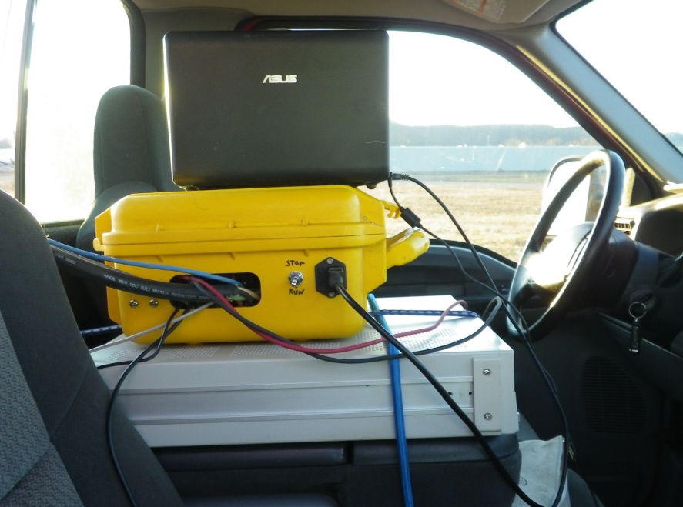
Where - Highway: Truck Testing
Pros
Cons
Availability
High Speed Winds
Cheap
Small turbines only
Non-laminar flow
Vibrations
Influenced by natural wind
Trees, power lines, sonic booms

Slide 10
Field Test Sites, Facilities
Put in appropriate places, not just convenient places
Have un-restricted access to test site
Customers expect turbine to work and make them $$$. Do not expect them to be your test sites.
Have appropriate basic infrastructure
Shelter
Power
Internet
Site access
Build what you need to, but remember that infrastructure takes a lot of time and $$$

Slide 11
Shelter
Environmental protection
Humans
Warm, dry, out of the wind, and comfortable
Food prep
Communications
Equipment
Specific to test
Mini shop
Supplies for basic maintenance and repairs
Basic tools
Heavy tools & fixtures
Safety Equipment
Hard hats, climbing harness, fire extinguisher, first aid kit

Slide 12
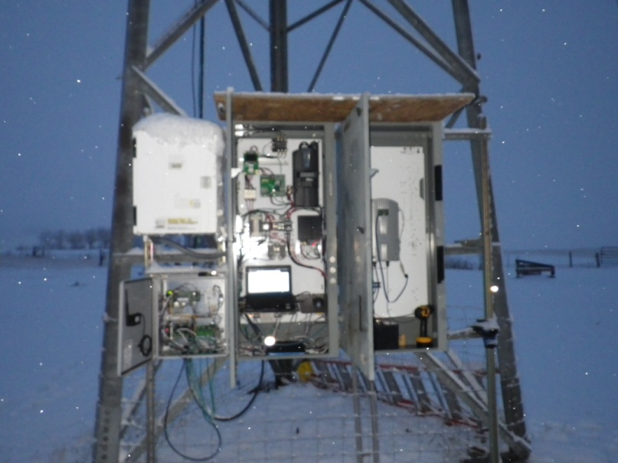
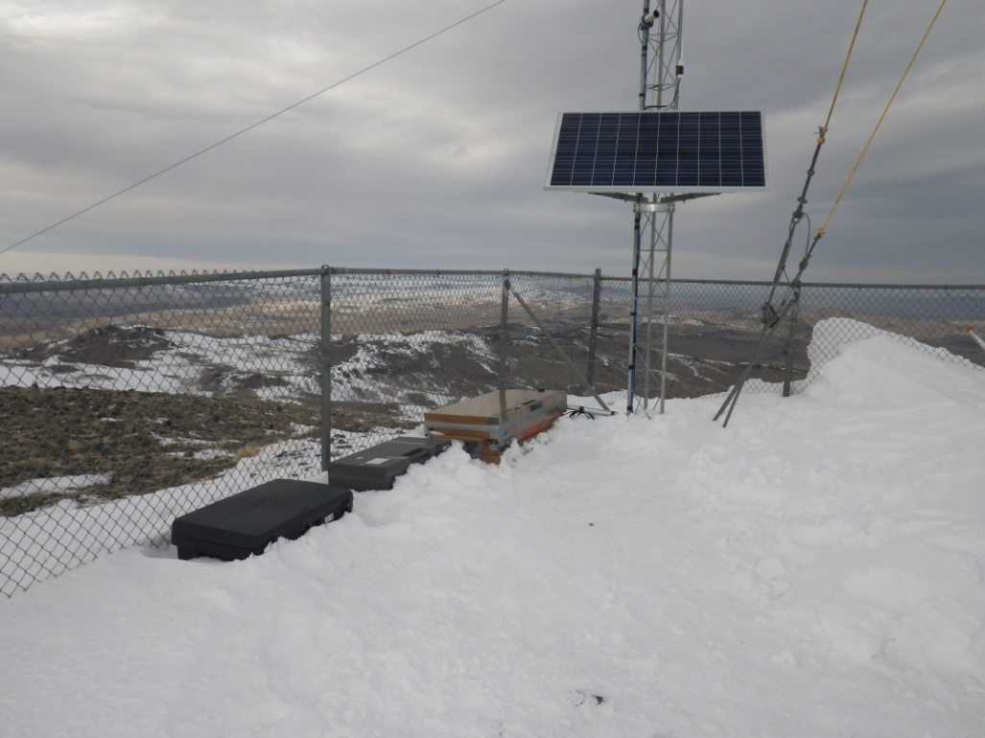
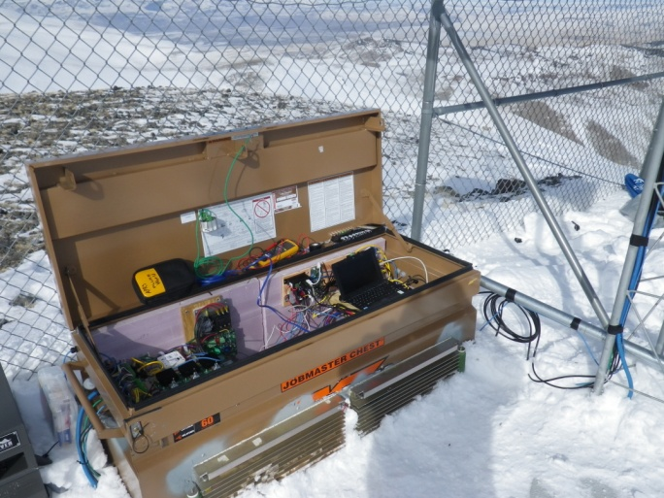
Bad Places to Work
Fact: Plywood alone does not
make humans comfortable
… but having a piece of plywood over your head would be an improvement in some places

Slide 13
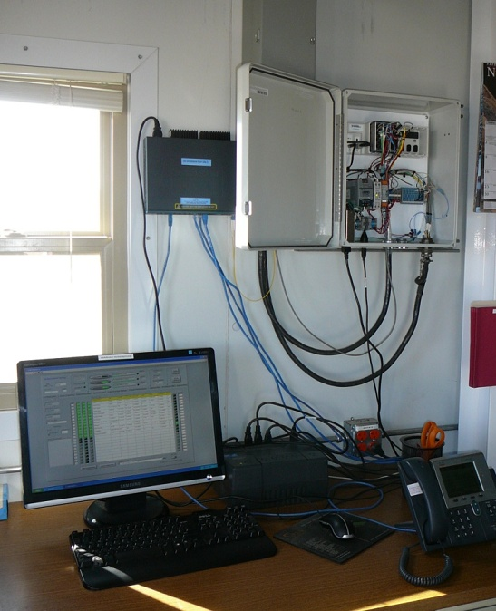
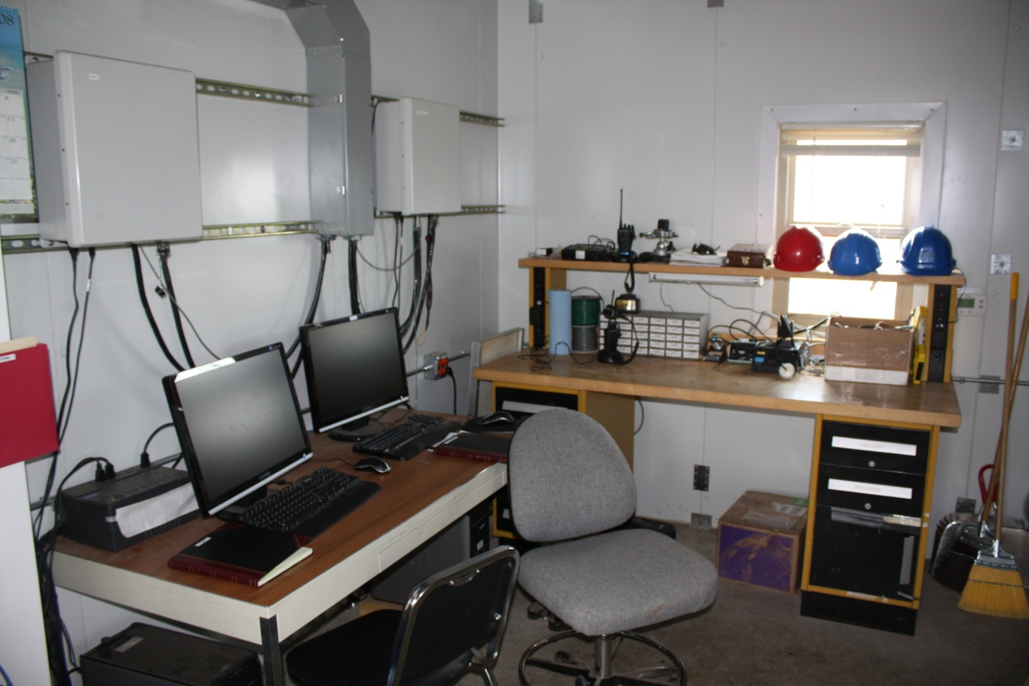
Good places to work, NREL
Photo courtesy of Amy Bowen / NREL
Photo from APRS World, LLC

Slide 14
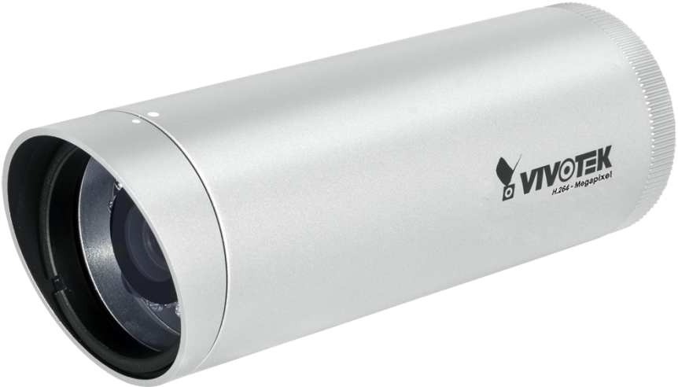
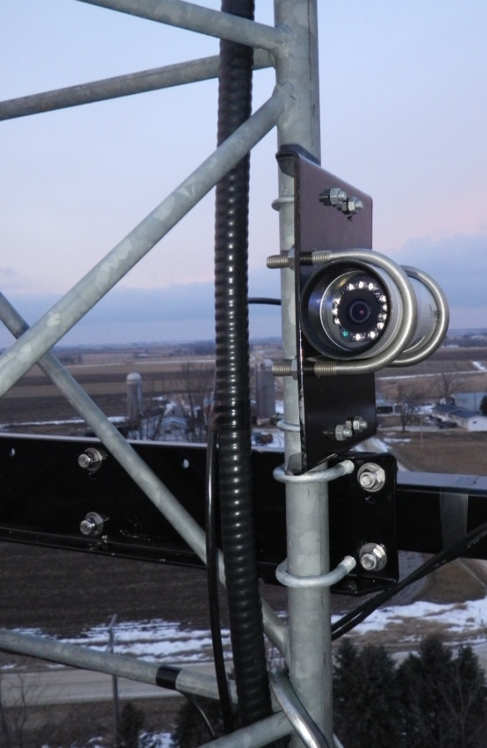
IP Cameras
Mega-pixel IP Cameras EVERYWHERE
Record video or periodic stills
Synchronize time between data sources
Place a camera very close to
turbine for infrared
Illumination at night
Cheap @ < $400 per camera

Slide 15
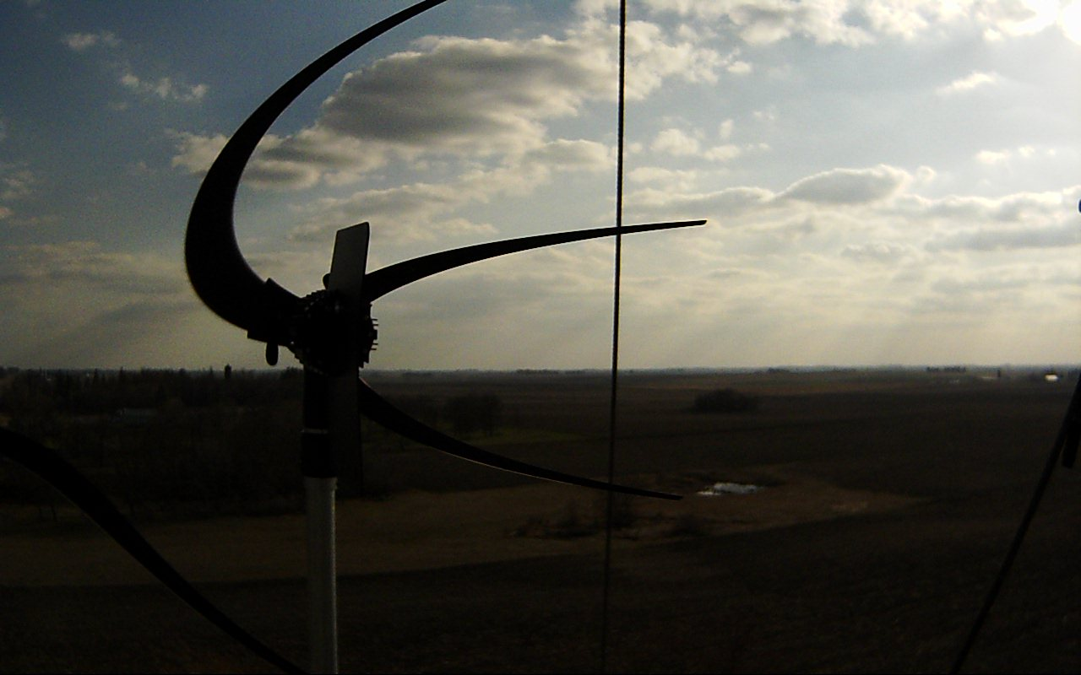
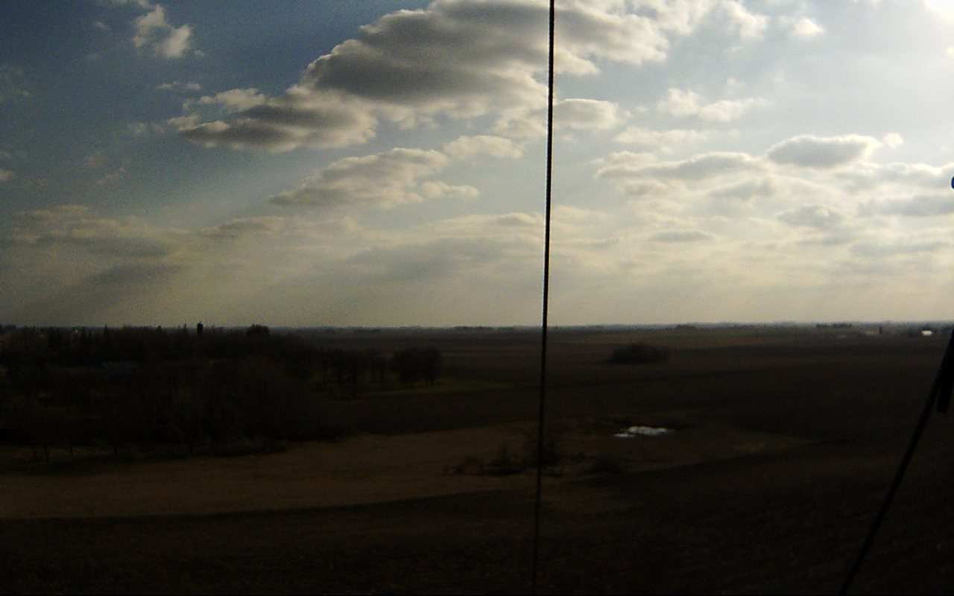
IP Camera Example
6:09PM
6:10PM

Slide 16
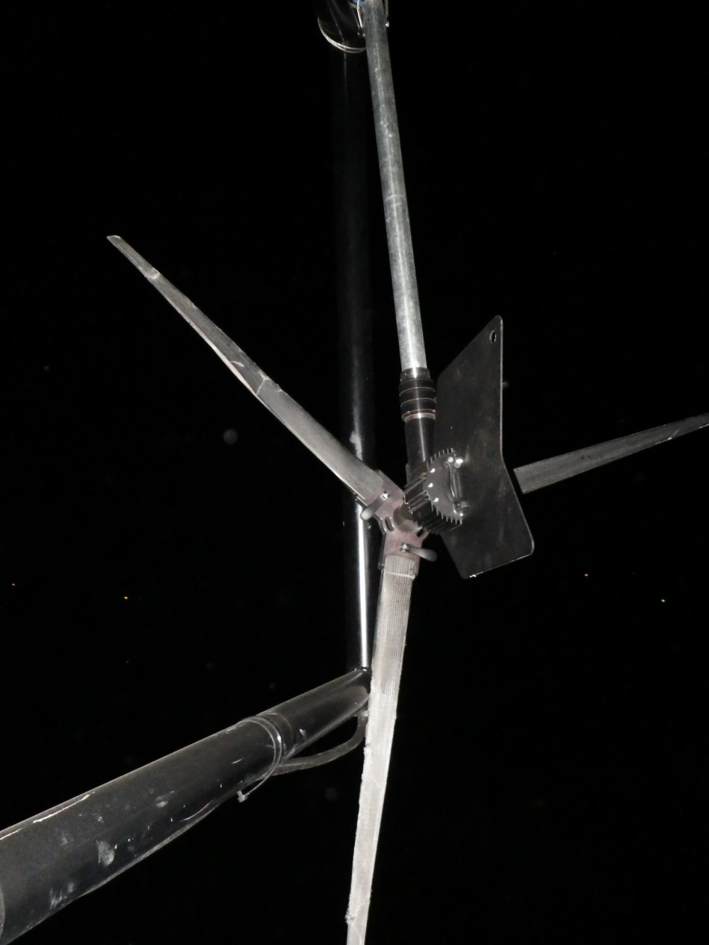
IP Camera Example, Continued
What I found
@ 8:55PM

Slide 17
Data
Look at it daily or more
Catch problems early
Integrate with your normal workflow
Daily e-mail?
iPod Touch before bed and first thing in the morning?
Second monitor at your desk?
Historical trends
Example: Decrease in RPM at given wind speed could indicate broken blade.

Slide 18
Turbines and Towers and Electronics (oh my!)
Certification is on turbine AND tower AND electronics
Develop strategy for testing sub-systems independently of each other
Dynamometer is great for testing generator and generator / inverter combination.
Test all of the pieces together!
Electronics do REALLY effect mechanical bits
Turbines can REALLY effect towers

Slide 19
When ready for certification testing?
Design is stable and meets relevant IEC standards
Turbine can survive for period of time and wind greater than what is required for endurance testing
When an approximation of all safety tests have been passed

Slide 20
Conclusions
Git ‘r done
Certification testing is perfection
Pre-certification testing making sure you are ready for perfection
Move fast, be agile
Test everything independently and together
Test early, test often
Test with more than one unit!

Slide 21
Be realistic!
e-mail: jj@aprsworld.com
web: www.aprsworld.com

Slide 22
Slides cut for lack of time…

Slide 23
Field Test Sites, Personnel
Service test sites internally or with contracted personnel.
No tinkerers
Good communicators!

Slide 24
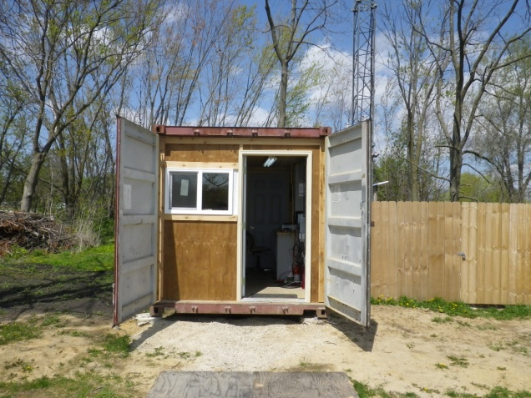
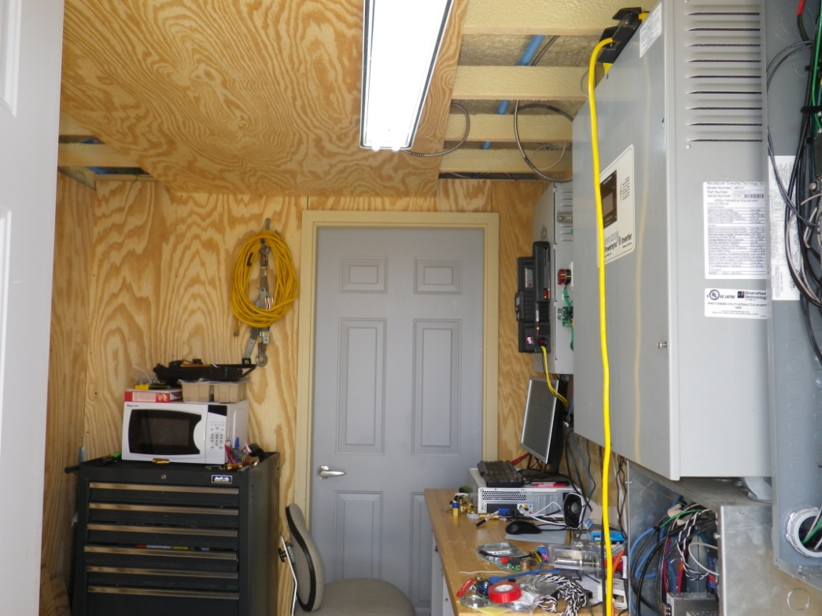
Good places to work, APRS World

Slide 25
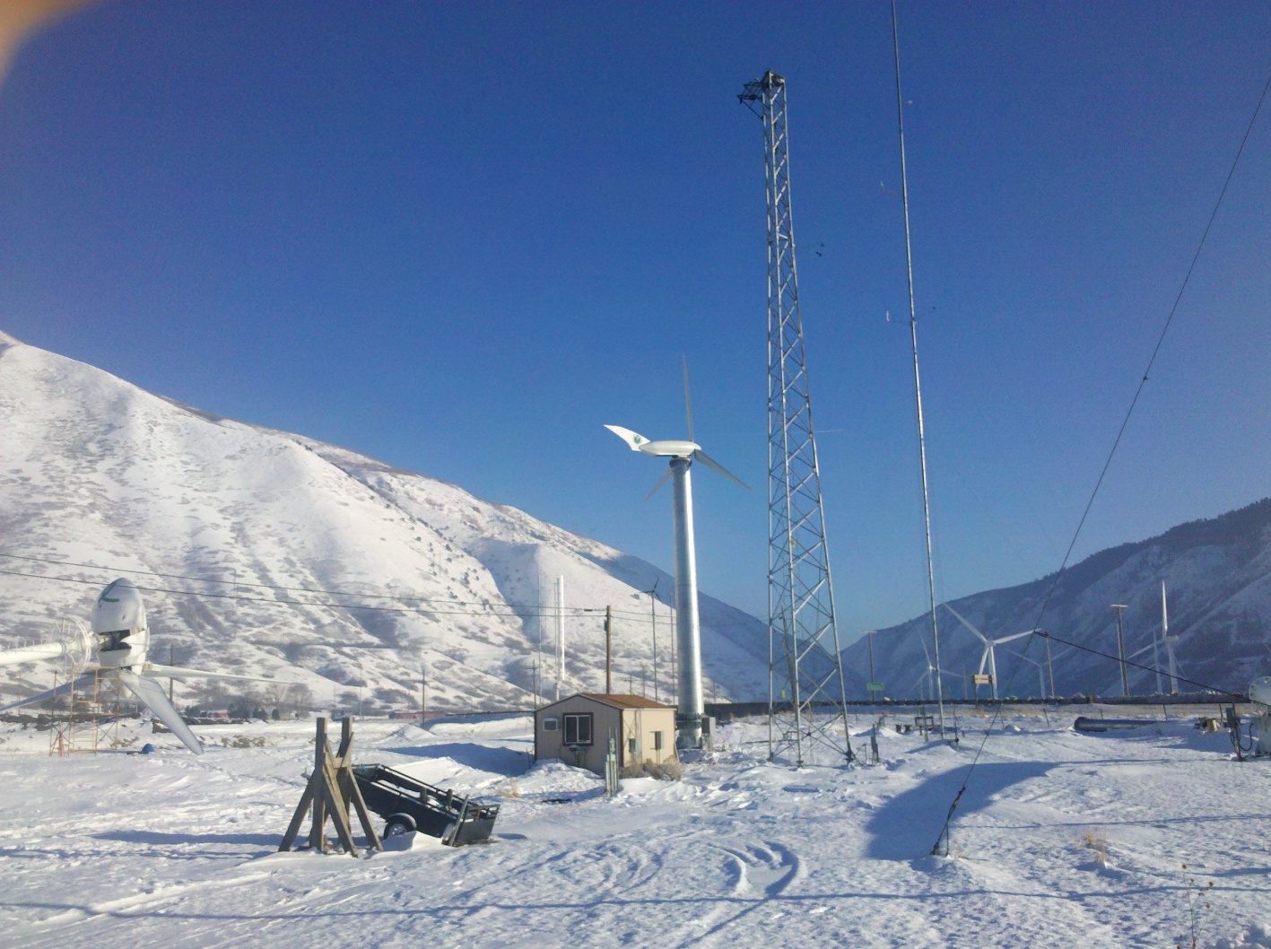
Good places to work, Windward Engineering

Slide 26
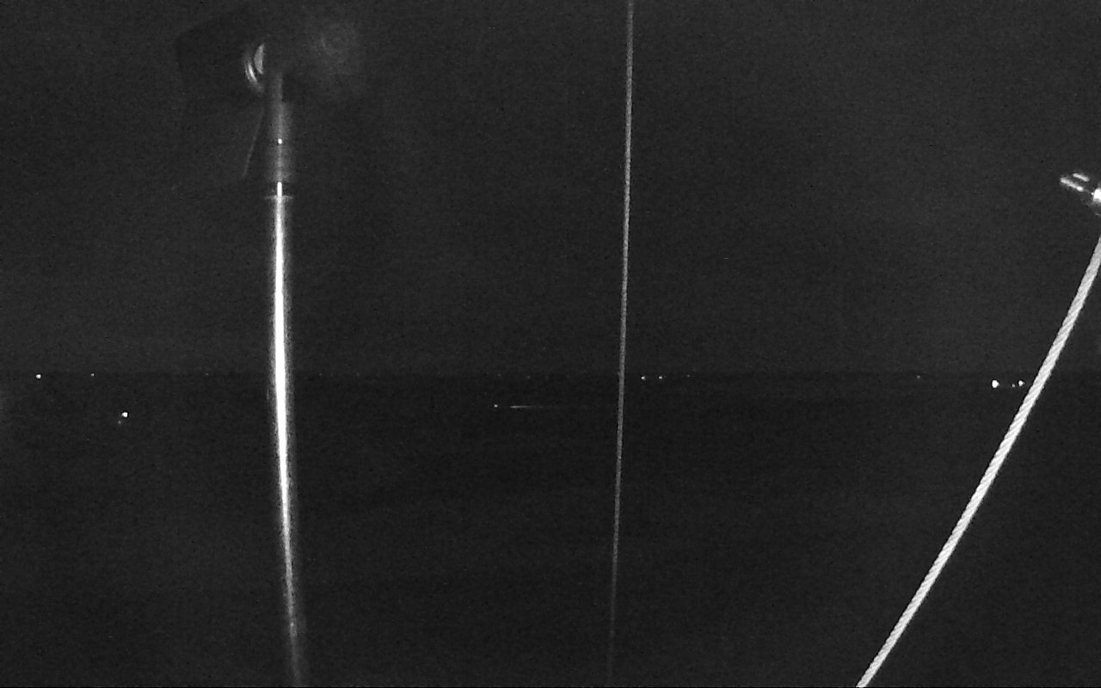
IP Camera, Infrared Example

Slide 27
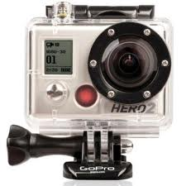
HD Video Cameras
Use to capture likely events
Example: Grid fault simulation
Quantity of data is staggering
10’s of gigabytes per hour
Hard to share over internet
Trade-off in size versus frame rate
Example: 120 FPS at WVGA, 30 FPS at 1080p
Hard to time synchronize automatically
Incredibly boring to watch
Cheap @ $300 per camera
(HD Hero 2)

Slide 28
VOIP – Voice Over IP
Inexpensive way to have reliable voice communications
Improve safety with fixed phone
for 911 / emergency
Three connections
Power
Ethernet / Internet
Normal telephone
Cheap @ < $0.02 per minute + $5 per month

Slide 29
Instrumentation
Wind
Anemometer, wind vane
Weather
Temperature, relative humidity, barometric pressure
Turbine
Voltage & Current to inverter / controller
Voltage & Current to grid / batteries
Advanced sensors
Vibration, Acoustics, Temperature, Oil health, etc

Slide 30
Meta-instrumentation
Load Health, Grid Tied
Grid voltage
Grid frequency
Load Health, Battery Charging
Battery voltage / state of charge
Dump load
Current
Duty cycle
Instrumentation health
Bus voltages
Computer connectivity, storage, etc

Slide 31
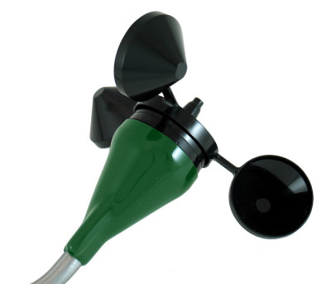
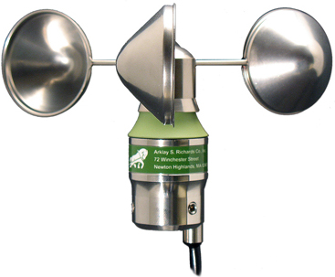
Instrumentation Redundancy
Instrumentation problem or turbine problem?
Consider different types / manufacturers of the same sensors

Slide 32
Sensor Quality
Quality of sensors driven by certainty of data required.
Your engineers are your customers.
Example: Does it matter if ambient air temperature reads 12ºC when it is 11.1ºC?

Slide 33
Data, processing
Automate! We use SQL.
SELECT
LEFT(packet_date,16) AS dateBin,
COUNT(packet_date) as n,
MIN(windSpeed0) AS ws0Min,
MAX(windSpeed0) ws0Max,
ROUND(AVG(windSpeed0),2) AS ws0Avg,
ROUND(STDDEV_POP(windSpeed0),2) AS ws0Stddev,
ROUND(MIN(vBattDisp*iBattDisp),2) AS pMin,
ROUND(MAX(vBattDisp*iBattDisp),2) AS pMax,
ROUND(AVG(vBattDisp*iBattDisp),2) AS pAvg,
ROUND(STDDEV_POP(vBattDisp*iBattDisp),2) AS pStddev
FROM
view_nvc9am_classic_monopole
WHERE
packet_date>='2012-03-15 00:00:00' AND packet_date<'2012-03-15 00:10:00'
GROUP BY
LEFT(packet_date,16);

Slide 34
Data, processing, continued

